Slide 1
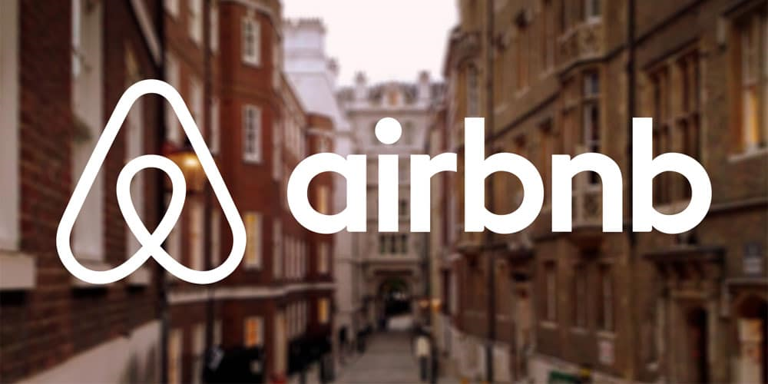
AIRBNB
New York City Analysis 2019
Data Analysis By Chirag Juneja

Slide 2
What are the most popular neighborhoods for Airbnb rentals in New York City? How do prices and availability vary by neighborhood?
Observing the most popular Airbnb in NYC
Manhattan and Brooklyn are the most popular boroughs for Airbnb rentals, with high listing counts.
The Bronx and Staten Island have fewer listings, potentially providing a more tranquil atmosphere.
Prices vary across boroughs, with Manhattan having the highest average price, followed by Brooklyn, Staten Island, Queens, and the Bronx.
Availability also differs, with Staten Island having the highest average availability, followed by Queens, Manhattan, Brooklyn, and the Bronx.

Slide 3
Observing the most popular Airbnb in NYC
Williamsburg and Bedford-Stuyvesant are popular neighborhoods with a high number of listings.
Midtown has the highest average prices, while Bushwick stands out for its affordability.
East Village and Williamsburg have shorter availability, while Midtown has longer availability.
Each neighborhood has a unique profile, attracting renters with diverse preferences and budgets.
Neighborhood dynamics vary, with some catering to cultural richness, artistic communities, or upscale experiences.

Slide 4
How has the Airbnb market in New York City changed over time? Have there been any significant trends in terms of the number of listings, prices, or occupancy rates?
Observing the Significant trends Over Time
Listing Count vs. Price: Higher listing counts don't necessarily correlate with higher prices. For example, Sonder (NYC) has more listings than Blueground but lower average prices.
Price vs. Availability: Higher prices don't always mean higher availability. Blueground has a high average price, but Sonder (NYC) and Jeremy & Laura have comparable or higher availabilities.
Availability Variability: Some hosts have a wide range of availability (e.g., Ken with 319 days), while others have limited availability or none at all (e.g., Kara).
Diverse Host Profiles: Different hosts cater to different segments of the market, with varying strategies in terms of pricing, availability, and the number of listings.

Slide 5
Are there any patterns or trends in terms of the types of properties that are being rented out on Airbnb in New York City? Are certain types of properties more popular or more expensive than others?
Observing the Trends of Properties In NYC
Entire apartments are popular, often with higher average prices.
Williamsburg is a popular neighborhood for both private rooms and entire apartments.
Hell's Kitchen and Bedford-Stuyvesant have high average prices for shared rooms.
Affordability and popularity of property types vary by neighborhood.
Neighborhood choice significantly influences average prices and availability.

Slide 6
Are there any factors that seem to be correalated with the prices of Airbnb rentals in New York City?
Observing The Factors That Correlated With Price
Private Room (Correlation: 0):
There is no linear correlation between the variable associated with Private Rooms and the other variable. This means that changes in one variable do not predict or explain changes in the other variable.
Entire Home/Apt (Correlation: -0.0338):
There is a very weak negative correlation between Entire Homes/Apartments and the other variable. However, the correlation is close to zero, suggesting that there is minimal linear relationship between the two.
Shared Room (Correlation: 0.9311):
There is a strong positive correlation between Shared Rooms and the other variable. This indicates that as one variable increases, the other tends to increase significantly. The positive correlation suggests a potential association or dependency between the two variables.

Slide 7
The best area in New York City for a host to buy property at a good price rate and in an area with high traffic ?
Observing The Best Area In NYC for a Host To Buy Properties in NYC
Sea Gate's Exclusive Luxury:
Sea Gate stands out with a high average price of $487.86, suggesting an exclusive and luxurious residential setting.
Limited availability adds to the neighborhood's allure, appealing to those seeking a premium living experience.
Downtown Brooklyn's Balance:
Downtown Brooklyn offers a balanced mix with an average availability of 39.48 and an average price of $150.35.
This central location provides diverse options, catering to a range of preferences and budgets.
Affordability in Morningside Heights:
Morningside Heights combines moderate availability (43.05) with affordability, boasting an average price of $114.78.
Ideal for those seeking a budget-friendly yet accessible neighborhood in the city.

Slide 8
How do the lengths of stay for Airbnb rentals in New York City vary by neighborhood? Do certain neighborhoods tend to attract longer or shorter stays?
Observing the Length of Stays in NYC
Stay Short, Stay Central:
Manhattan dominates with the highest total counts, particularly for shorter minimum stays of 1 to 3 nights.
Brooklyn closely follows, indicating a preference for shorter-term rentals.
Staten Island's Longer Retreats:
Staten Island stands out for listings requiring longer minimum stays, suggesting a potential focus on extended stays or a distinct rental market.
Diverse Borough Preferences:
While Manhattan and Brooklyn favor shorter stays, Queens and Bronx also show substantial counts for 1-night minimums.
Each borough reflects a unique pattern, revealing the diverse preferences in the New York City rental landscape.

Slide 9
How do the ratings of Airbnb rentals in New York City compare to their prices? Are higher-priced rentals more likely to have higher ratings?
Observing the Price and Ratings in NYC
Riverdale's Allure:
Private rooms in Riverdale shine with an average price of $804 and a solid rating of 51.
Popular choices in Midtown and Jamaica Estates also provide unique stays.
Fort Wadsworth's Home Retreats:
Fort Wadsworth leads in entire home listings at $800, although with a neutral rating.
Woodrow and Sea Gate offer potential luxury experiences with higher prices.
Riverdale's Shared Harmony:
Shared rooms in Riverdale top the list at $800, featuring a collaborative living experience.
Vinegar Hill and Financial District present diverse shared room options with varying ratings.

Slide 10
Find the total numbers of Reviews and Maximum Reviews by Each Neighborhood Group.
Observing the Most Reviewed Neighborhood in NYC
Review Royalty:
Manhattan reigns supreme with 21,661 reviews, followed closely by Brooklyn's 20,104.
Each borough showcases its unique charm, drawing visitors and reviews.
Neighborhood Gems:
Park Slope, Harlem, Jamaica, Tompkinsville, and Murray Hill shine as the top-reviewed neighborhoods in their respective boroughs.
Diverse neighborhoods offer distinct experiences, capturing the attention of reviewers.
Harlem's Star Power:
Harlem steals the spotlight with an impressive 607 reviews, becoming the ultimate review magnet.
Other boroughs boast their own star neighborhoods, contributing to New York's vibrant review landscape.

Slide 11
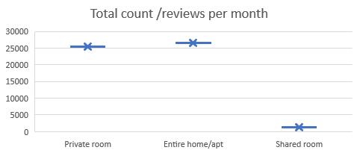
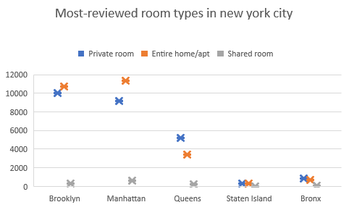
Find Most reviewed room type in Neighborhood groups per month.
Observing the Popularity of Room types in NYC
Room Type Popularity:
Private rooms are the most popular, with the highest total count/reviews per month.
Entire homes/apartments closely follow, indicating strong demand for private accommodations.
Shared rooms have a lower count, but they still attract notable interest.
Neighborhood Review Counts:
Brooklyn leads in total reviews for private rooms and entire homes/apartments compared to Manhattan.
Queens outshines Staten Island in total reviews, showcasing higher guest engagement.
The Bronx, while with fewer counts, demonstrates a growing interest, particularly in private rooms.

Slide 12
Find Best location listing/property location for travelers.
Observing the Best Listing Property/Location for Travelers
Top Pick for Travelers:
Staten Island: Highest reviews (31) and availability (200), making it a strong contender.
Queens: Budget-friendly average price ($100) with a good number of reviews (28).
Brooklyn: Balanced option with moderate price ($124) and reviews (24).
Consideration for Premium Experience:
Manhattan: Higher average price ($197) but still popular with 21 reviews.
Availability Factor:
Staten Island: Stands out with the highest availability score (200).
Brooklyn and Manhattan: Offer balanced availability (100 and 112,

Slide 13
11.Find also best location listing/property location for Hosts
Observing the Best Listing Property/Location for Hosts
Manhattan Marvel:
Manhattan leads with the highest listing count (21,661), offering hosts a vast market to attract guests.
Brooklyn's Bounty:
Brooklyn follows closely with a substantial listing count (20,104), presenting hosts with diverse hosting opportunities.
Queens and Bronx Affordability:
Queens and Bronx offer budget-friendly average prices ($100 and $87, respectively), appealing to cost-conscious travelers.
Staten Island's Niche Appeal:
Staten Island, with a lower listing count (373), provides hosts an opportunity to cater to a potentially more exclusive or niche market.
Balancing Act with Availability:
Hosts can enhance their hosting experience by emphasizing availability, with Staten Island standing out with the highest availability score (200).

Slide 14
Find Price variations in NYC Neighborhood groups.
Observing the Price Variations in NYC
The price variation among the neighborhood groups ranges from $87 (Bronx) to $197 (Manhattan), resulting in a substantial difference of $110. This diversity in average prices reflects the varied affordability and premium options available across different boroughs, catering to a broad spectrum of travelers with different budget considerations.

